Slide 1
Summary of datasets
Data were collected by the International Livestock Research Institute and are available in 2 Excel files on Learn
The first dataset includes sampling data for leptospirosis collected from people living in villages in rural Kenya in 2013 and 2014
The second dataset includes sampling data for three cattle diseases (brucellosis, rift valley fever, Q fever) in rural Kenya in 2020 and 2021
Other information collected for each sample include: data on demographics person/animal sampled, locational data on person/animal sampled (anonymised), behavioural data on person/animal sampled

Slide 2
Leptospirosis dataset

Slide 3
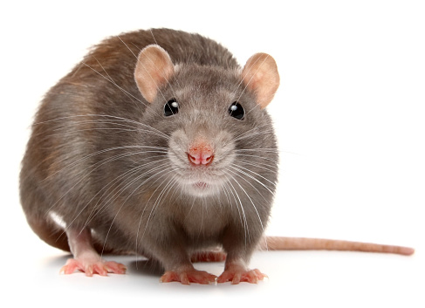
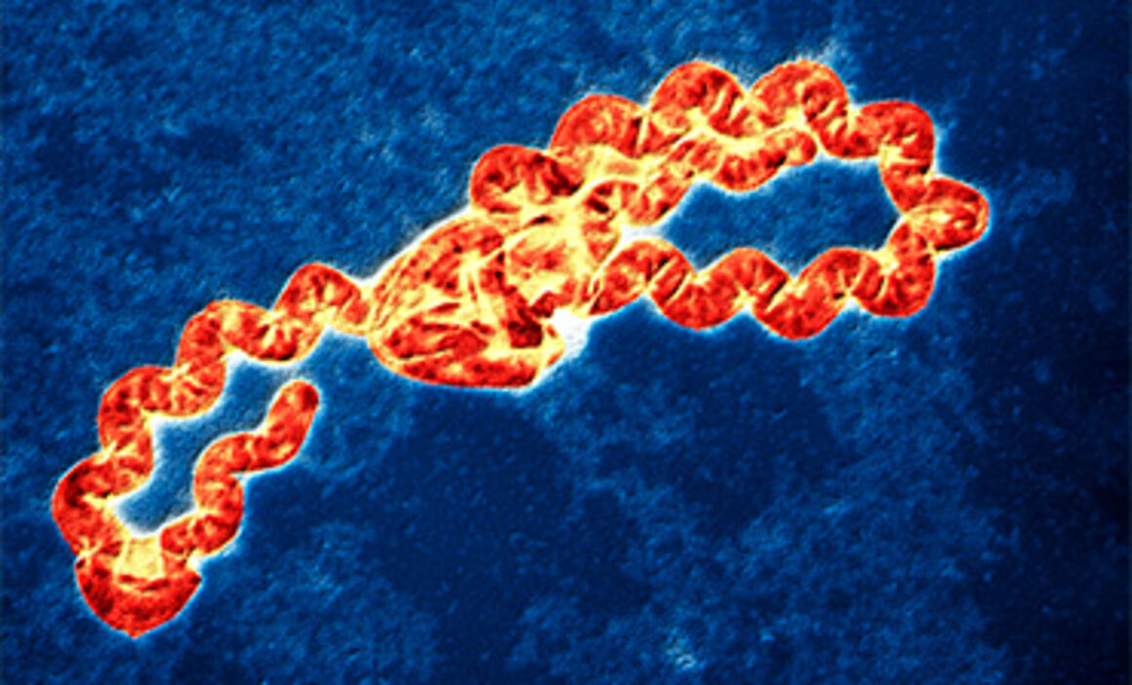
Leptospirosis is a bacterial disease affecting humans and animals spread by contact with infected urine
Each row represents leptospirosis result from one sample taken from a person on a given date from a specific household
Questionnaire responses from person tested is recorded which includes demographic information (age, sex) as well as behavioural information of respondent and their head of household
Information on respondents’ behaviour regarding animal contact and occupation are recorded as well as information on location of their household

Slide 4
Research Aims
Project aim: To identify individual risk factors associated with leptospirosis infection in a rural area of Kenya
To explore prevalence of leptospirosis in different demographic groups and locations
Account for potential problems in the dataset that may affect validity of different data analysis methods
Possible analysis methods:
Exploratory analysis (prevalence of leptospirosis by age, sex, occupation etc)
Use appropriate model to examine effect of different variables on whether or not an individual tested positive for leptospirosis (contact with animals, dist to hospital, occupation)
Account for hierarchical structure of data

Slide 5
Cattle disease dataset

Slide 6
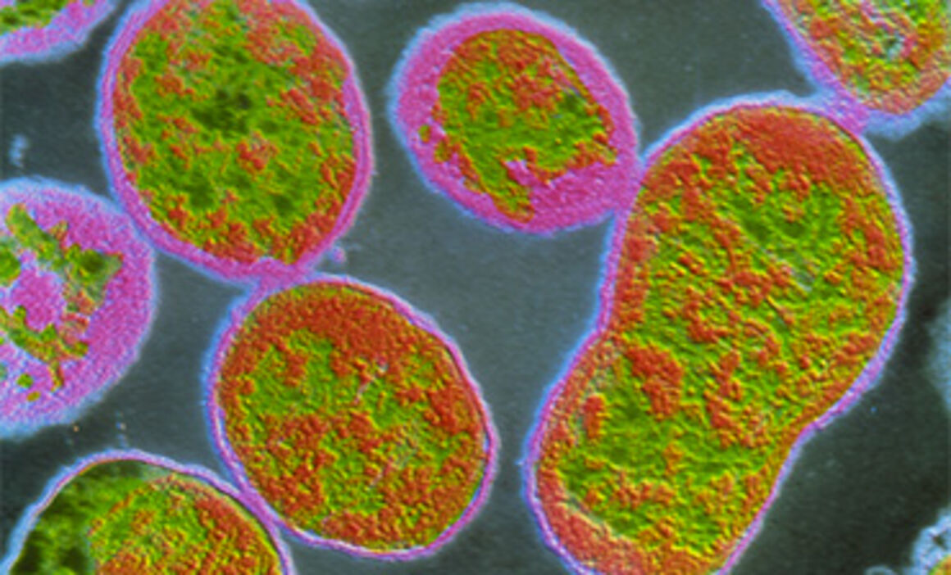
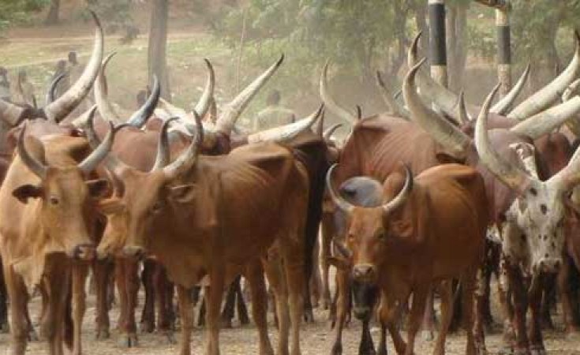
Brucellosis: bacterial disease common in animals such as cattle, sheep, goats
Rift valley fever: virus found in domesticated animals transmitted by mosquitoes
Q fever: bacterial disease affecting domestic animals spread via airborne droplets
Each row represents results of tests for three common cattle diseases from one sample taken from a cow on a given date and location
Other data include demographic information of tested cow, information about the herd which the tested cow came from, and information about the location of the herd

Slide 7
Research Aims
Project aim: To identify risk factors associated with different infections for cattle herds in rural Kenya
To explore prevalence of different diseases in different areas
Account for potential problems in the dataset that may affect validity of different data analysis methods
Possible analysis methods:
Exploratory analysis (prevalence of different cattle diseases per area)
Use appropriate models to examine effect of different variables on whether or not a cow has been infected with each pathogen
Account for hierarchical structure of data

Slide 8
Data limitations/problems with dataset to consider
Leptospirosis dataset
Large numbers of missing data in some columns; large numbers of negative results
Few households recorded not keeping livestock in homes
disthosp may be used as a proxy for how connected an area is to towns/cities
Cattle disease dataset
sample_date column contains dates with different formats
Large numbers of negative results (more of a problem for some diseases – e.g. rvf)
Spatial correlation may be present in these data (closer locations may be expected to have similar infection rates)
Both datasets have hierarchical structure (this is the case in both datasets)

Slide 9
Analysis methods
Consider appropriate tools/R packages for making plots (ggplot2, base)
Think about appropriate modelling tools to identify risk factors associated with infection
- accounting for hierarchical nature of data
- accounting for large numbers of negative results
- with appropriate response variable distribution (binomial model? Poisson?)
- making use of appropriate methods for model/variable selection
Decide how you would like to analyse the data – at the level of the individual or at the level of the household/village/herd
Useful R packages for fitting mixed models and for dealing with zero-inflation include lme4 and glmmTMB

Slide 10
References
Cook et al. 2017. Risk factors for leptospirosis seropositivity in slaughterhouse workers in western Kenya. Occupational and Environmental Medicine 74 http://dx.doi.org/10.1136/oemed-2016-103895
Goarant. 2016. Leptospirosis: risk factors and management challenges in developing countries. Research and Reports in Tropical Medicine 7: 49-64. doi: 10.2147/RRTM.S102543
Nakeel et al. 2016. A Sero-epidemiological Survey of Brucellosis, Q-Fever and Leptospirosis in Livestock and Humans and Associated Risk Factors in Kajiado County-Kenya. Journal of Tropical Diseases 4:3 http://dx.doi.org/10.4172/2329-891X.1000215
Soo et al. 2020. Leptospirosis: Increasing importance in developing countries. Acta Tropica
doi: 10.1016/j.actatropica.2019.105183
Bates et al. 2014. Fitting linear mixed-effects models using lme4.
https://doi.org/10.48550/arXiv.1406.5823
Zuur et al. 2009. Mixed effects models and extensions in ecology with R. Springer (available at https://link.springer.com/book/10.1007/978-0-387-87458-6)

Slide 11
Resources
Models in R:
lme4:
https://cran.r-project.org/web/packages/lme4/lme4.pdf
glmmTMB:
https://cran.r-project.org/web/packages/glmmTMB/glmmTMB.pdf
Examples:
Using lme4:
https://jontalle.web.engr.illinois.edu/MISC/lme4/bw_LME_tutorial.pdf
Using glmmTMB:
https://www.biorxiv.org/content/biorxiv/suppl/2017/05/01/132753.DC1/132753-2.pdf
gglot2 in R:
http://r-statistics.co/Complete-Ggplot2-Tutorial-Part1-With-R-Code.html

